Slide 1
AI and Data Analytics Presentation
By Anand Low Hong Ren

Slide 2
Time Series Forecasting - MVSS Monthly Part Expenditure Prediction
normal machine learning dataset is actually a collection of observations (factors/features)
E.g.: Determining an plant species
Flower colour
Petal length
Leaf type
Time series adds order dependence or relationship between observations and time
Time is both a constraint and a structure
Goal: Predict the future based on past events and observations.

Slide 3

Concerns of Forecasting
How much data available
Time duration of predictions that is required (short, medium, long)
Can the data be updated frequently?
Temporal frequency of the data (mins, hrs, days, months, years)
Notes:
Since the observations are related to time, how much data also depends on how much time is spent collecting the data.

Slide 4

Useful applications of Time Series Forecasting
Closing price of stocks each day
Birth rate at all hospitals in a city each year
Product sales in units sold each day for a store.
Number of passengers through a train station each day.
Average price of petrol each day.

Slide 5
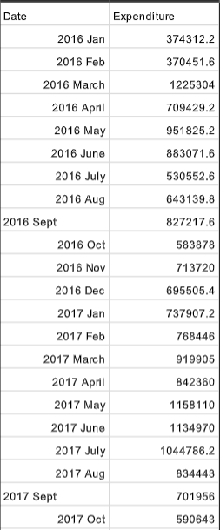
Dataset
Calculated from Parts’ Inventory List
Consist of MVSS monthly expenditure on parts
Data ranges from 2016 January to 2020 December
Only takes into account purchased and sold parts, does not include other factors. (univariate time series)

Slide 6
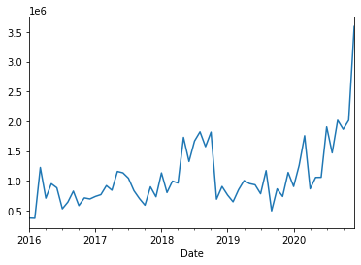
Data Visualization - Line Graph
2016, 2017 and 2019, the parts expenditure ranges from RM0.4 mil to RM1.3 mil. .
For 2018 and 2020, we can see spikes up to around RM2 mil.
At the end of 2020 parts’ expenditure increased to a high of around RM3.6 mil.

Slide 7
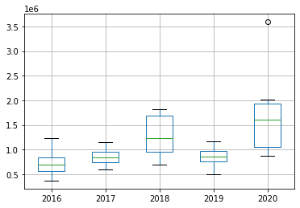
Data Visualization - Boxplot
Expenditure from 2018, 2020 is higher.

Slide 8
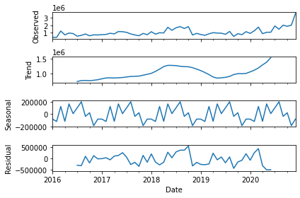
Data Analysis
Trend: The increasing or decreasing value in the series.
Seasonality: The repeating short-term cycle in the series.
Noise: The random variation in the series.
Notes:
Trend: 2018 and 2020 have higher total part expenditure
Seasonality: expenditure in june may have the highest. It goes up and down because one month buy the part another month use almost finish only purchase again.

Slide 9
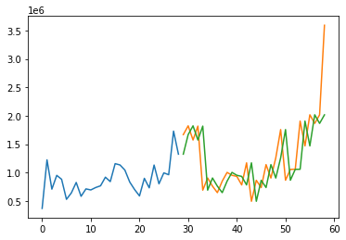
Persistence Algorithm
Used as a baseline model, as a reference for future modifications and improvements.
Uses previous observation to predict the next observation.
Naive
Test RMSE: 504309.899
Average Accuracy: 70%

Slide 10


AutoRegression Model for Forecasting
A regression model such as linear regression models an output value based on a linear combination of input values.
yhat is the prediction, b0 and b1 are coefficients found by optimizing the model on training data, X is an input value.
If predict the value for next time step using current and previous time step value,
Notes:
Use how many lags as a predictor depends on how useful the lag is to predict the next value. This relationship between previous value and current value can be determine through a few methods.

Slide 11
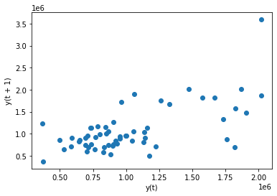
Lag Scatter Plot
Time series modelling assumes a relationship between an observation and the previous observation.
Explore the relationship between the current observation and the previous observation (lag1).
spending variance between months is evident, thus the lag and the observation have a low correlation relationship.
Notes:
The previous observations in a time series are called lags. The observation at the previous time step is called lag1.
Lag scatter plots explore the relationship between each observation and the lag of that observation.
If the points cluster along a diagonal line from the bottom-left to the top-right of the plot, it suggests a positive correlation relationship.
If the points cluster along a diagonal line from the top-left to the bottom-right, it suggests a negative correlation relationship.
Either relationship is good as they can be modeled.

Slide 12
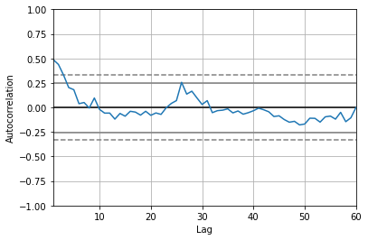
Autocorrelation Plot
Shows the correlation between different lag and observation
Lag 1 has the highest positive correlation at just under 0.50.
Lag1 will be created for the prediction.
Notes:
strength and type of relationship between observations and their lags.
A value close to
zero suggests a weak correlation, whereas a value closer to -1 or 1 indicates a strong correlation.

Slide 13
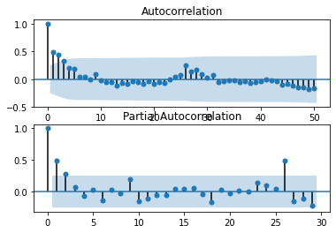
ACF is an auto-correlation function which gives us values of auto-correlation of observations with its lagged values
PACF is a partial autocorrelation function. It finds correlation of the residual ( remains after removing the effects which are already explained by the earlier lags) with the next lag value.

Slide 14
Moving Average Models for Forecasting
Residual error: difference between expected and predicted
Residual errors can have temporal structure like trends, bias and seasonality.
Temporal structure suggests information that can be incorporated into the predictive model

Slide 15
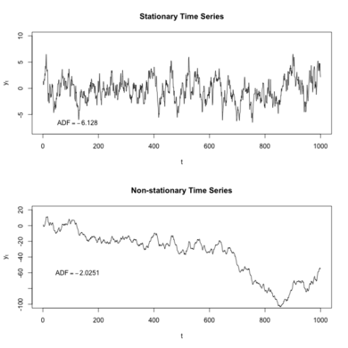
Stationary Time Series
non - stationary time series shows seasonal effects, trends and other structures that depend on the time index.
Observations in a stationary time series are not dependent on time. Constant mean.
Statistical modeling methods assume or require the time series to be stationary to be effective.

Slide 16

ARIMA
Short for AutoRegressive Integrated Moving Average
A class of models that explains a given time series based on its own past values
p is the order of the AR term
Number of lags used as predictors
q is the order of the MA term
Number of lagged forecast errors
d is the number of differencing required to make the time series stationary

Slide 17
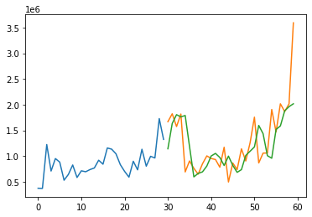
Manually Configured ARIMA model
50% Training data, 50% Test data
p: 0, d: 1, q: 2
Test RMSE: 482224.493
Average accuracy of 71.29%

Slide 18
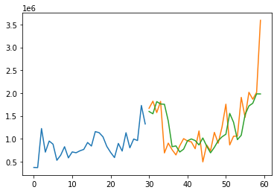
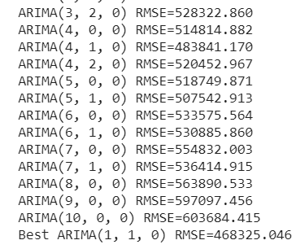
Grid Search ARIMA Hyperparameters
Average accuracy = 73%
Notes:
Run possible configurations for p,d and q from 0 - 10.

Slide 19
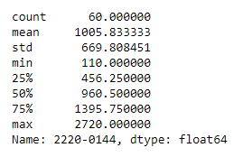
30 common parts’ consumption in MVSS
Time Series Forecasting also can be applied when managing inventory
The Purchase of the 30 more common parts are used.
LED model RES,SMD,150R,1%,0.25W,1206 will be used as an example

Slide 20
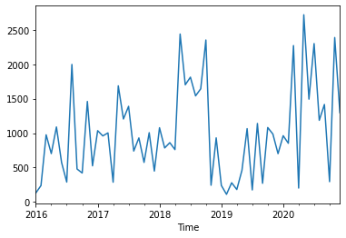
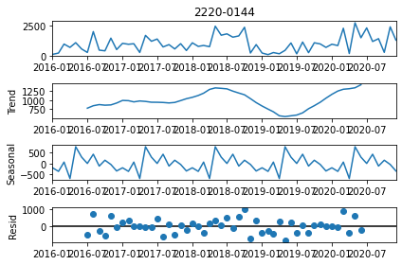
Data Visualization

Slide 21
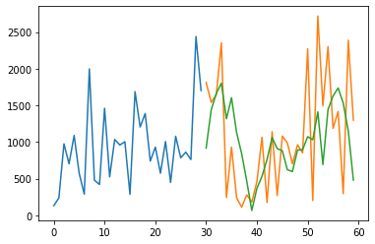
ARIMA results
Best ARIMA(0, 0, 5) RMSE=697.553

Slide 22

Key Takeaways
Time Series Forecasting can be used as a tool to aid or predict future purchases so that parts won’t be overbought.
Other factors such as market trends, purchase timings, personal experiences can be processed into data that can improve the accuracy of the forecasting.
Time Series Forecasting have wide range of useful and practical applications that can be explored.

Slide 23


Slide 24


